Slide 1

Note: The data and information in this document is reflective of a hypothetical situation and client. This document is to be used for KPMG Virtual Internship purposes only.
Sprocket Central Pty Ltd
Data analytics approach
[Division Name] - [Engagement Manager], [Senior Consultant], [Junior Consultant]

Slide 2
Note: The data and information in this document is reflective of a hypothetical situation and client. This document is to be used for KPMG Virtual Internship purposes only.
Agenda
Introduction
Data Exploration
Model Development
Interpretation

Slide 3
Note: The data and information in this document is reflective of a hypothetical situation and client. This document is to be used for KPMG Virtual Internship purposes only.
Introduction
Identify and Recommend top 1000 customers from the Dataset.
Problem Statement
Sprocket is a company that specializes in high quality bikes and cycling accessories.
The aim is to identify and recommend top 1000 customers based on the 3 datasets provided that can be targeted by their marketing team to drive valuable business decision making.

Slide 4
Note: The data and information in this document is reflective of a hypothetical situation and client. This document is to be used for KPMG Virtual Internship purposes only.
Data Exploration
Data Quality Assessment
Issues with the Data
Additional customer IDs in Customer Addresses table and Transactions table other than Customer Demographics table.
Various features such as online_order, brand, job_title, job_industry_category have missing values.
Some of the features such as gender and state have inconsistent information(e.g. F, Femal, Female for Female or M, Male for Male or NSW, New South Wales for New South Wales.)
Features such as default in Customer Demographics table and deceased_indicator have irrelevant information such as deceased customers and incomprehensible values in default feature.
Irrelevant datatypes in product_first_sold_date. Date feature should have date datatype but it had integer datatype.

Slide 5
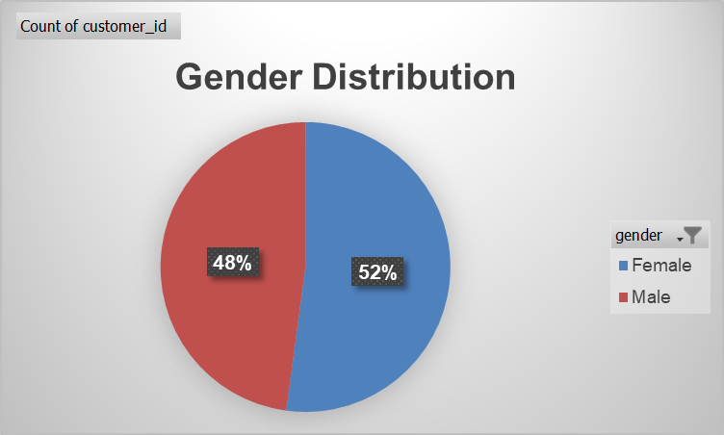
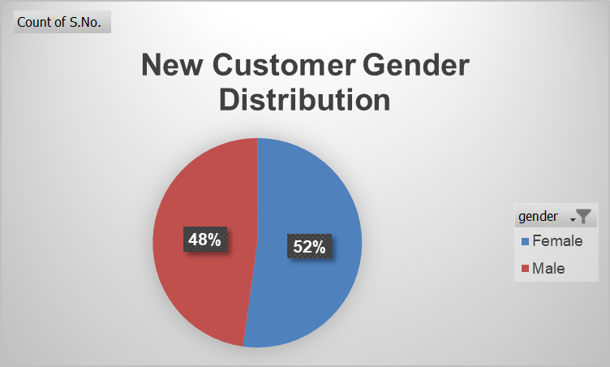
Note: The data and information in this document is reflective of a hypothetical situation and client. This document is to be used for KPMG Virtual Internship purposes only.
Data Exploration
Customer Distribution by Gender
Both the genders are almost equally distributed among the customers.
Distribution of genders is same for both new and old customers.

Slide 6
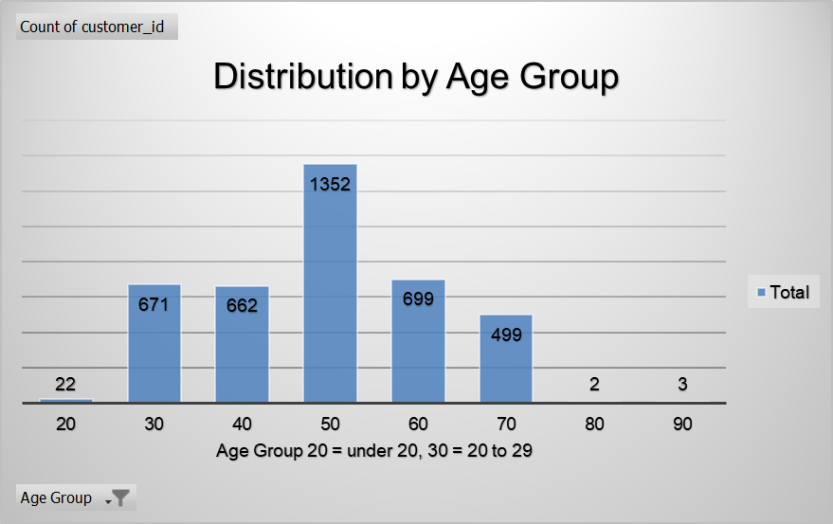
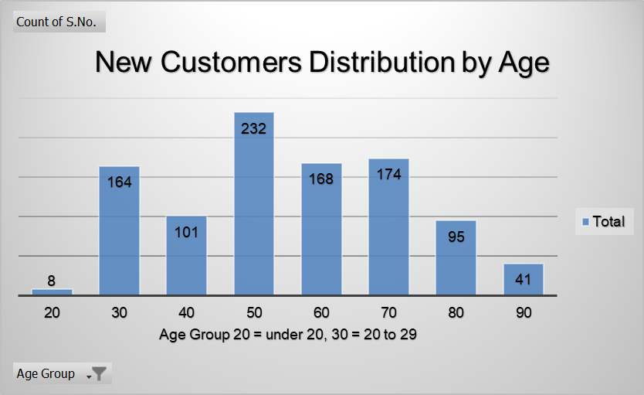
Note: The data and information in this document is reflective of a hypothetical situation and client. This document is to be used for KPMG Virtual Internship purposes only.
Data Exploration
Customer Distribution by Age
Highest number of customers are in the age group of 40 to 49 years for both old and new customers.
Only a few customers are below the age of 20.
More than 50% of the customers lie in the age group of 40 to 69 years.
In case of Old customers both the age groups of 20 to 29 and 30 to 39 years have almost same number of customers, however in case of New customers there is a sharp decline of customers in age group of 30 to 39 as compared to 20 to 29 years.
Overall Distribution of customers by age is same for both New and Old Customers.

Slide 7
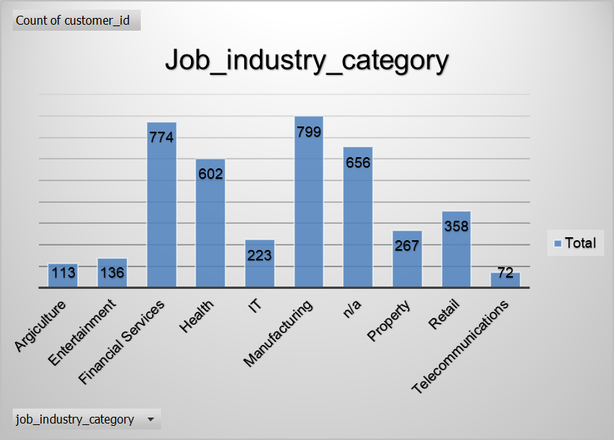
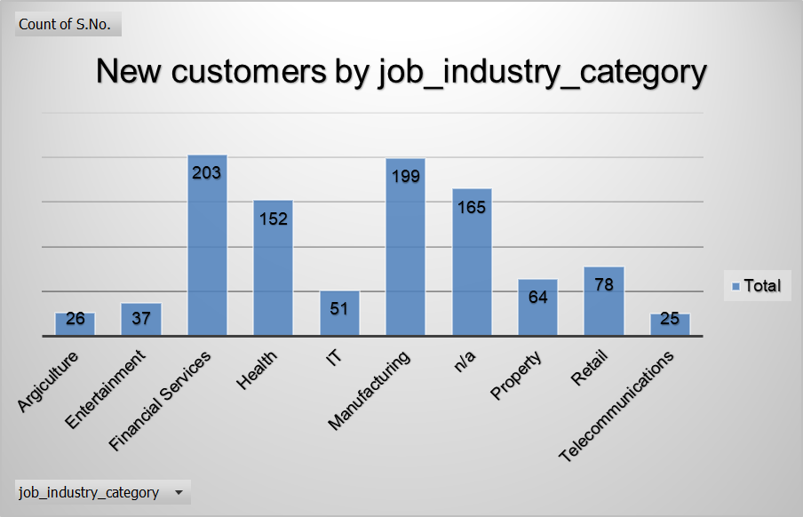
Note: The data and information in this document is reflective of a hypothetical situation and client. This document is to be used for KPMG Virtual Internship purposes only.
Data Exploration
Customer Distribution by job_industry_category
Most of the customers belong to Financial Services, Health, Manufacturing and n/a industry category for both New and Old customers.
The overall distribution of customers in different industries is also same for both Old and New customers.
Since a very large number of customers belong to n/a industry, identification of this industry is very important for targeting customers.

Slide 8
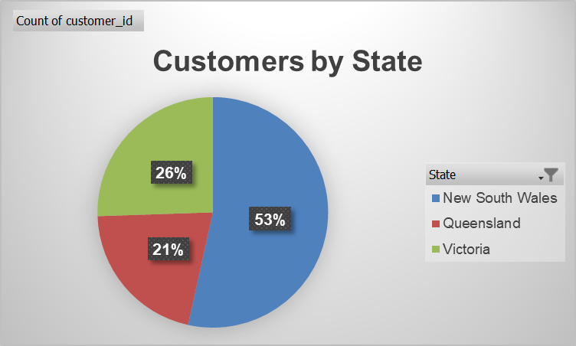
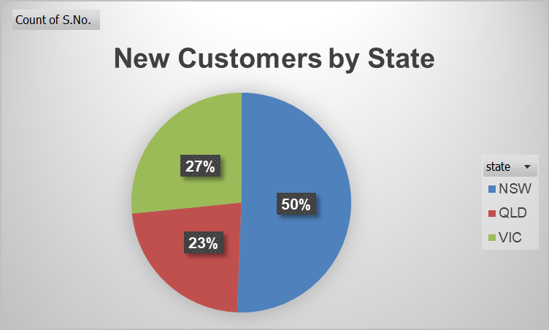
Note: The data and information in this document is reflective of a hypothetical situation and client. This document is to be used for KPMG Virtual Internship purposes only.
Data Exploration
Customer Distribution by State
All the customers belong to three states New South Wales, Queensland and Victoria.
Highest number of customers stay in New South Wales.

Slide 9
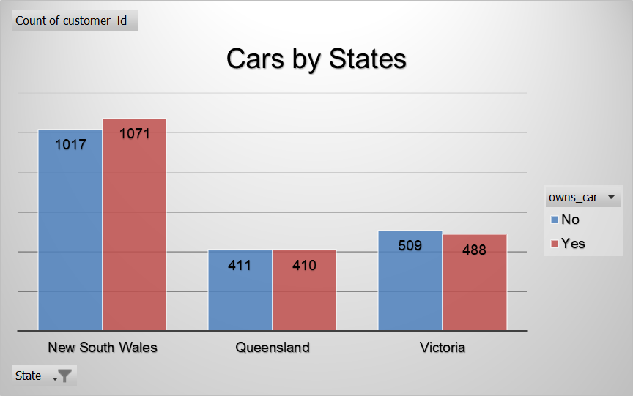
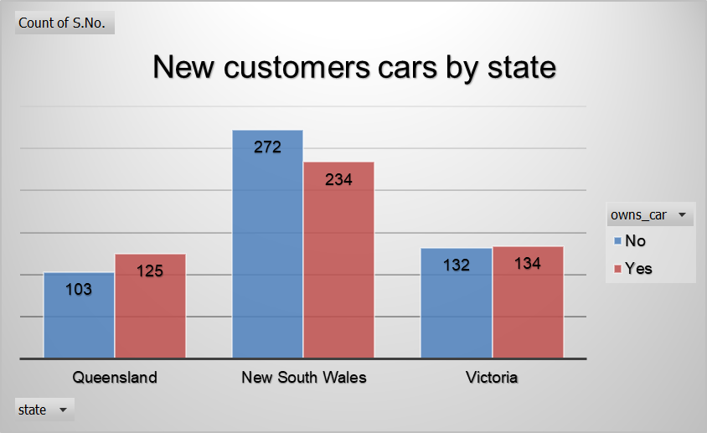
Note: The data and information in this document is reflective of a hypothetical situation and client. This document is to be used for KPMG Virtual Internship purposes only.
Data Exploration
Distribution of Cars by State
In each state there is an almost equal number of customers that have car and that do not have car.
Highest number of customers that have car and that do not have car belong to New South Wales which goes with the overall distribution of customers in these states where highest number of customers belong to New South Wales.
The overall distribution of cars for both New and Old customers is the same.

Slide 10
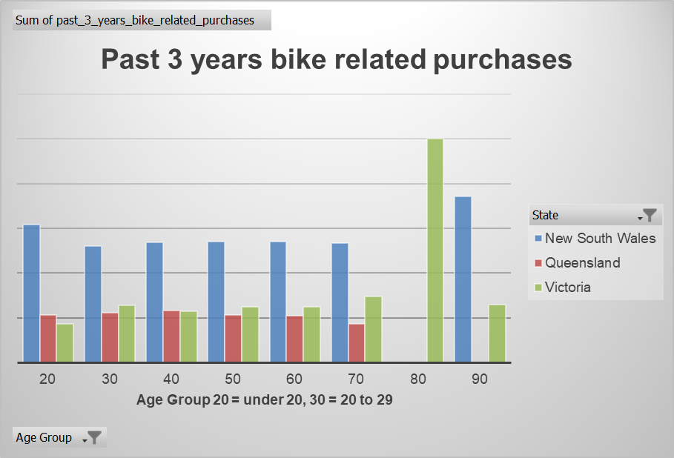
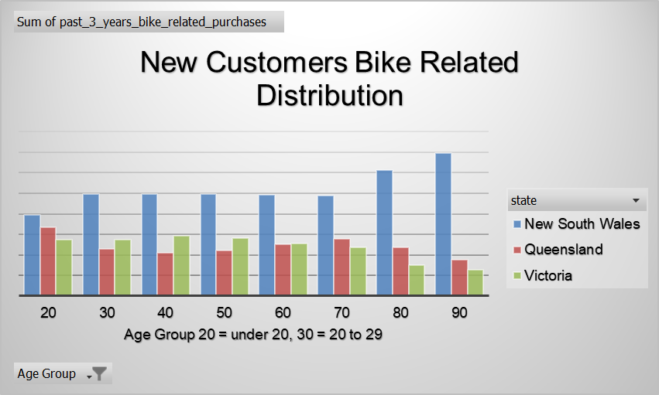
Note: The data and information in this document is reflective of a hypothetical situation and client. This document is to be used for KPMG Virtual Internship purposes only.
Data Exploration
Percentage Distribution of Bikes by States in each Age Group
The majority of Bikes in all Age groups have been bought in New South Wales.
In case of Old Customers in the Age group of 70 to 79 bikes have only been bought in Victoria State where as in the age group of 80 to 89 bikes have not been bought in Queensland State.

Slide 11
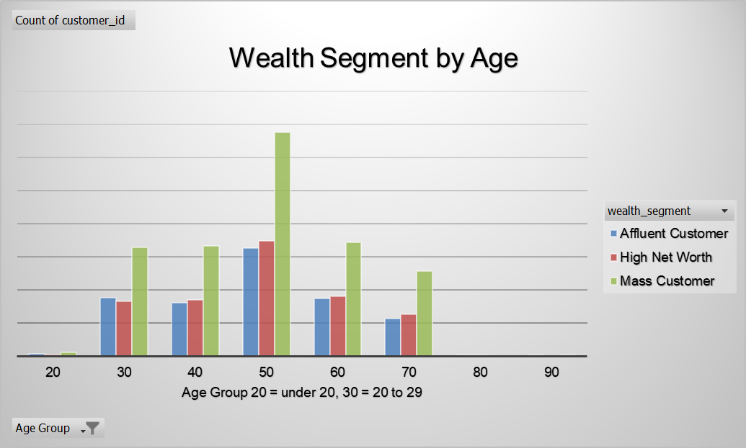
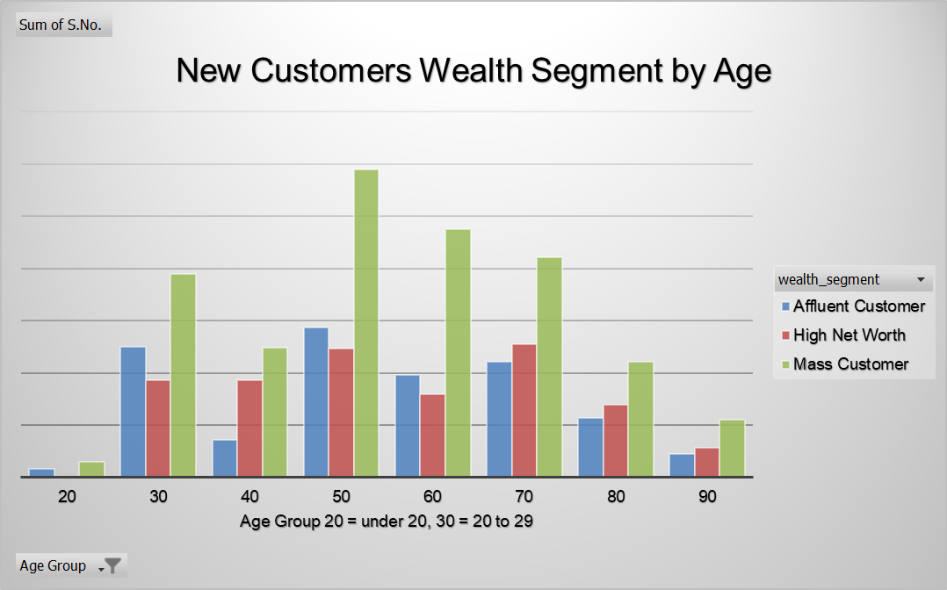
Note: The data and information in this document is reflective of a hypothetical situation and client. This document is to be used for KPMG Virtual Internship purposes only.
Data Exploration
Distribution of Customers by Wealth Segment in each Age Group
Majority of customers are Mass Customers in all Age Groups.

Slide 12
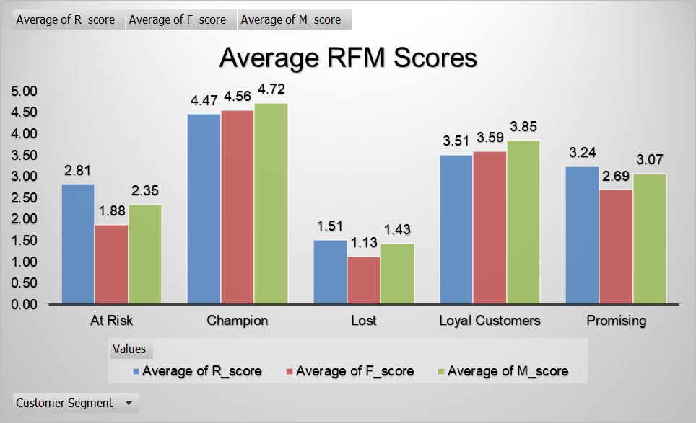
Note: The data and information in this document is reflective of a hypothetical situation and client. This document is to be used for KPMG Virtual Internship purposes only.
Model Development
Customer Segmentation based on RFM Analysis.
Customer Segmentation has been done based on RFM technique.
RFM works on Recency, Frequency and Monetary value of Purchase of a customer.
Customers in the Champion segment have highest RFM scores while customers in lost segment have the lowest RFM Scores.

Slide 13
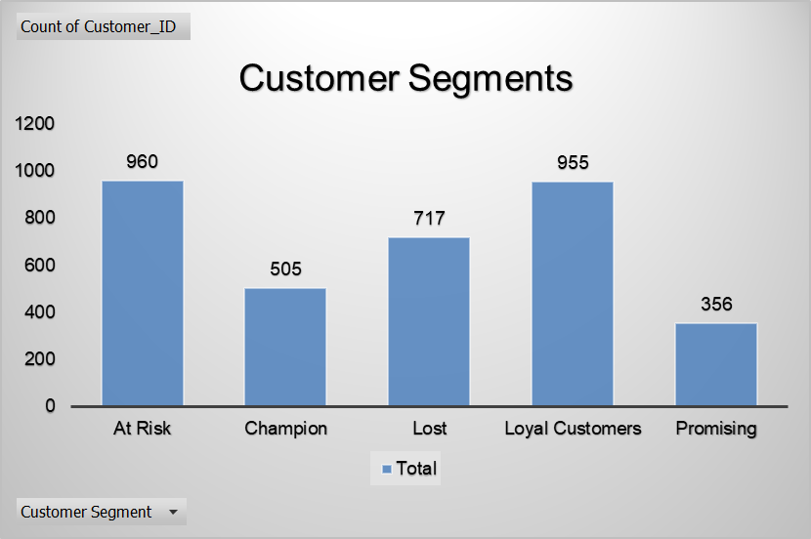
Note: The data and information in this document is reflective of a hypothetical situation and client. This document is to be used for KPMG Virtual Internship purposes only.
Model Development
Customer Segmentation based on RFM Analysis.
There are an almost equal number of “Loyal” and “At Risk” customers.
Champion customers are the ones who have bought most recently, have highest frequency of purchase and the highest monetary value of purchase They are the best customers. We can convert them these customers to our advocacy group by giving them exclusive benefits
Loyal customers have low recency, high frequency and monetary value of purchase, however they are not yet up to the mark of champions. A bit upselling and limited time offers could work wonders for the company.
Promising customers have average Recency, frequency and monetary value of purchase.
High Risk customers have above average recency, below average frequency and monetary value of purchase. It would require personalized approach and bigger discounts .
Lost customers have not at all bought recently, have very low frequency and monetary value of purchase. It won’t be worth working resources to turn them
Top 1000 customers can be selected from Champion and Loyal customers.

Slide 14
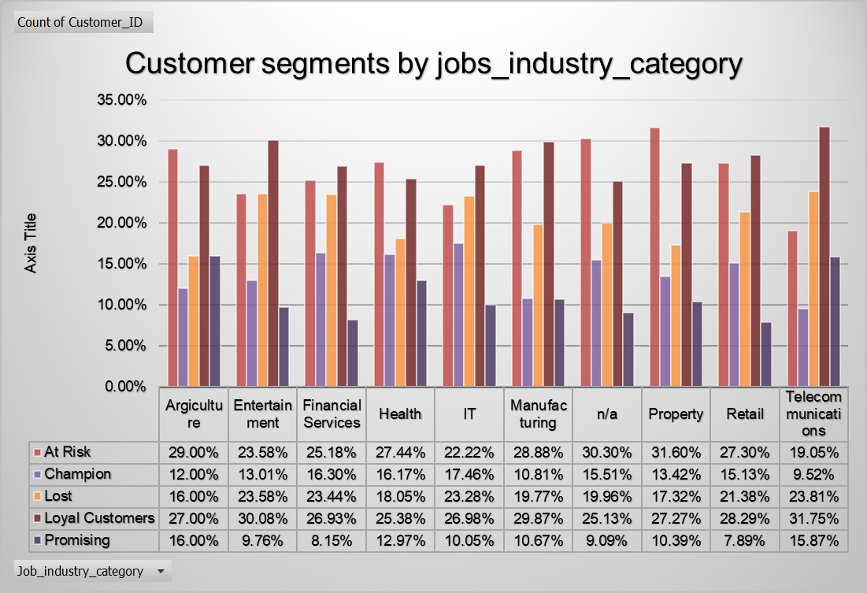
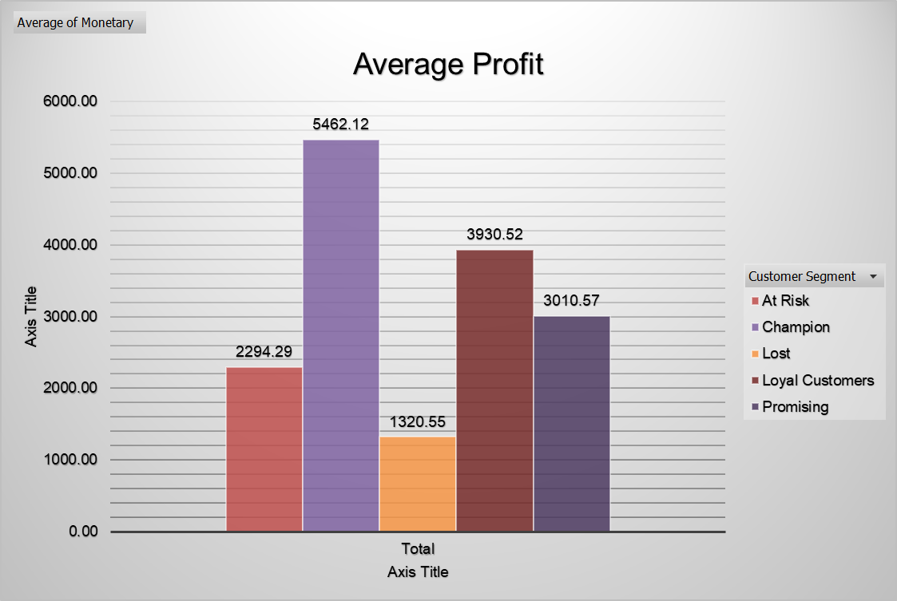
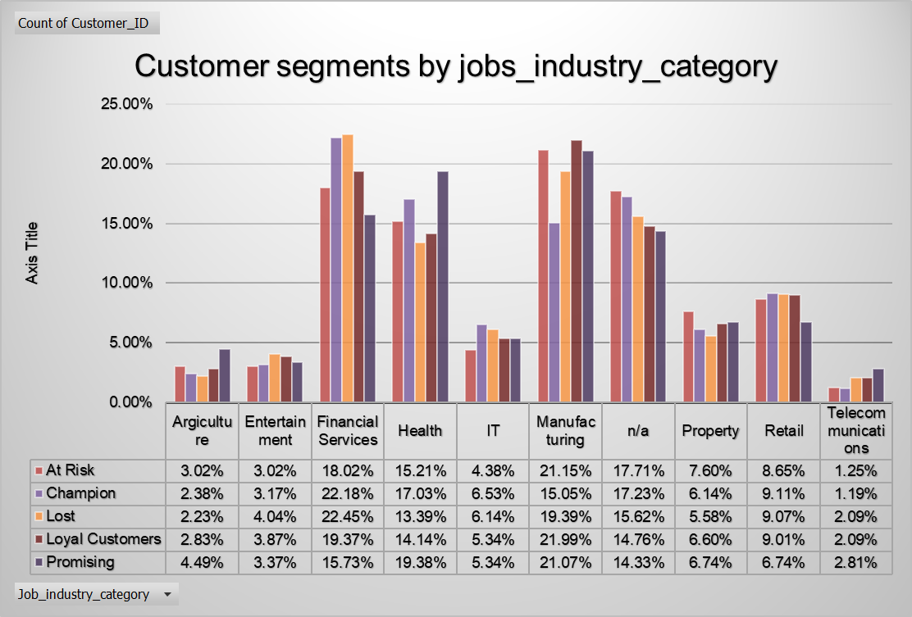
Note: The data and information in this document is reflective of a hypothetical situation and client. This document is to be used for KPMG Virtual Internship purposes only.
Interpretation
Customer Segments by job_industry_category.
Almost 22% of the champion customers belong to the Financial Services industry.
Almost 23% of customers in IT, Financial Services and Entertainment Industry are lost customers.
Almost 21% of customers in Manufacturing Industry are Promising who can be made loyal customers.
Champions have the highest average profit of $5462.12.

